Slide 1
Probabilistic Peak Load Estimation in Smart Cities Using Smart Meter Data
Mingyang Sun,Goran Strbac, Imperial College London,
Yi Wang,Chongqing Kang, Tsinghua University.
IEEE TRANSACTION ON INDUSTRIAL ELECTRONICS, VOL.66, NO.2, FEBRUARY 2019
2017-2018 IF: 7.050

Slide 2
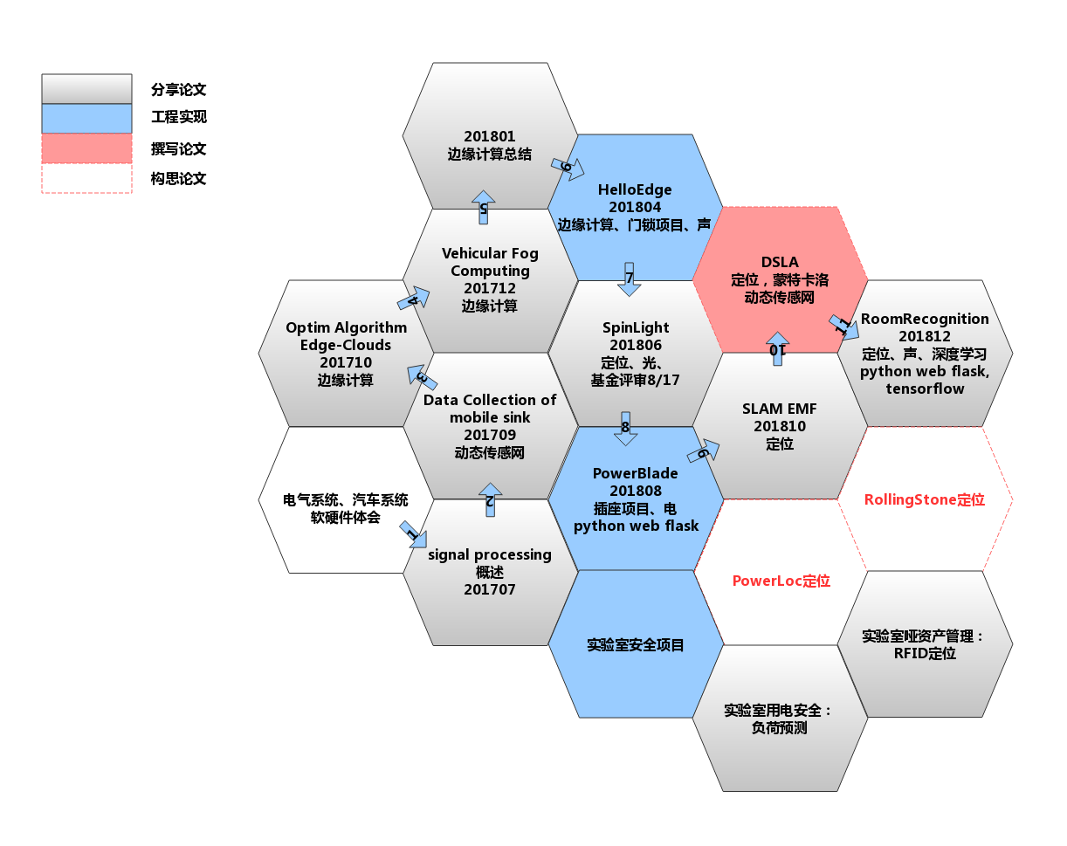


Research based on engineer project
论文分享12，其中，
边缘计算：3次
定位研究：3次
安全预测：1次
传感网络：1次
工程项目相关论文3次，
HelloEdge, PowerBlade, LoadEstimation
加工论文1次，
定位研究：DSLA

Slide 3
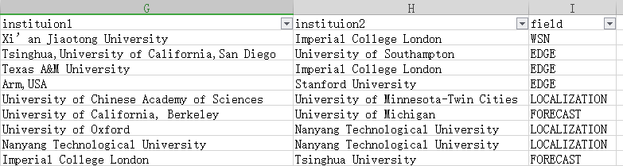
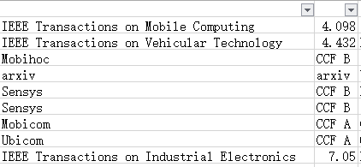
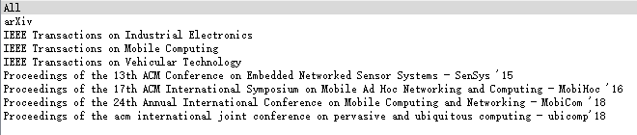
Research based on engineer project
SenSys19' General chairs: xiaofan.jiang
Notes:
帝国理工:3; 南洋理工:3; Tsinghua: 2; 加州大学:2; 牛津大学:1; 德州农工:1; 斯坦福:1; 南开普敦:1; 密歇根大学：1； 西交：1； 明尼苏达：1； ARM： 1；
SenSys 15 两次

Slide 4
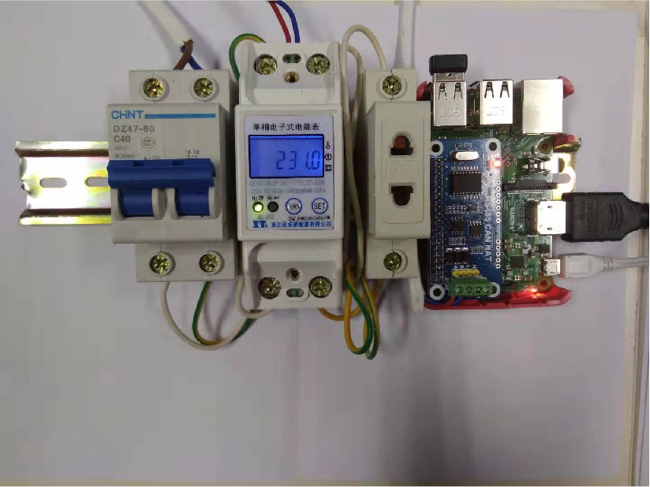

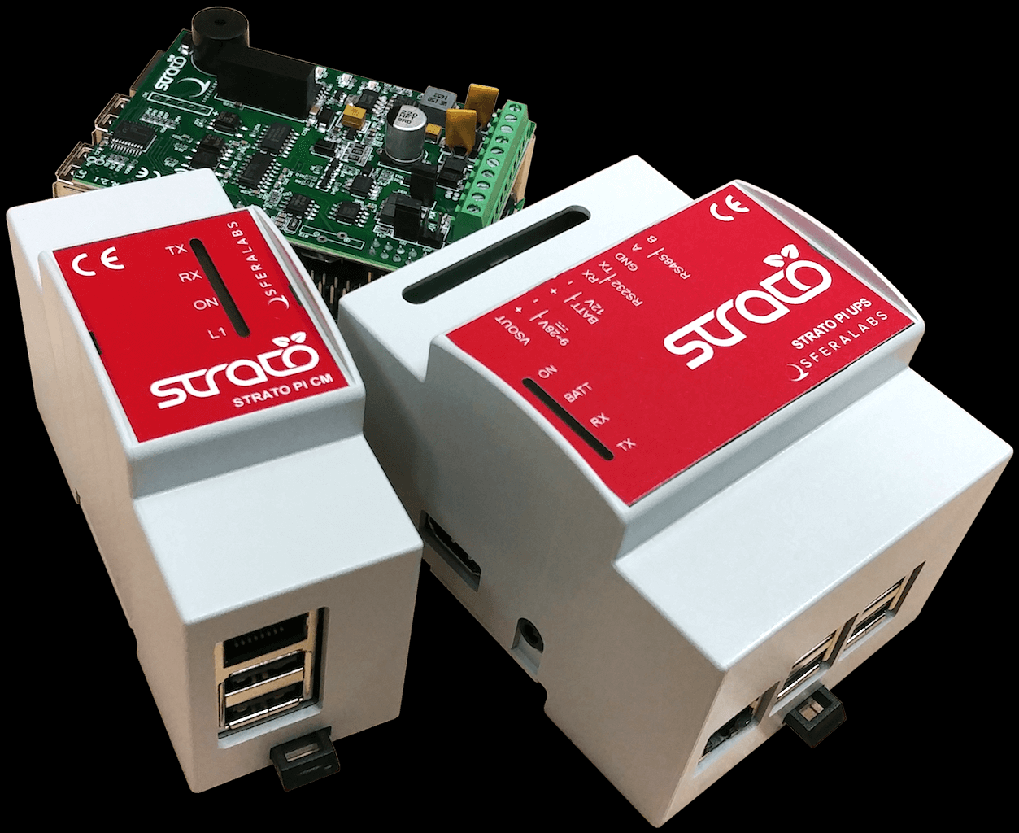
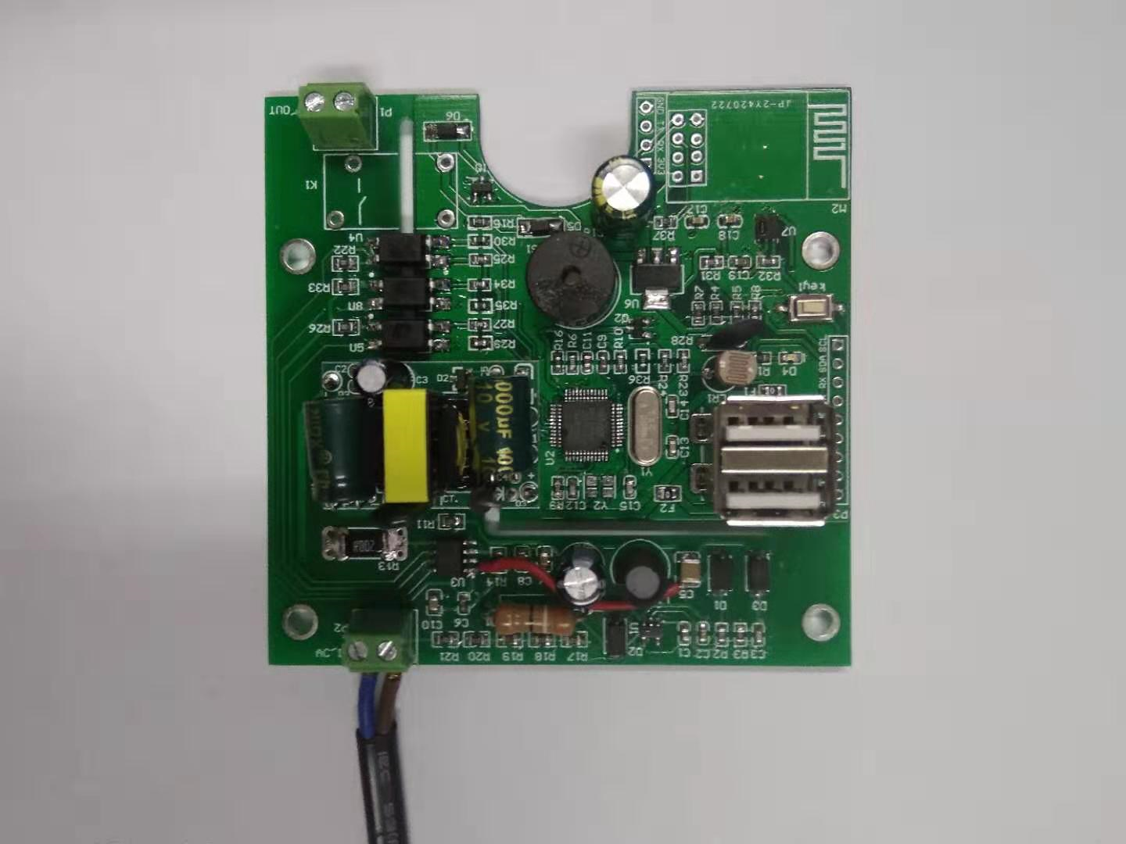
Research based on engineer project
more fine grained
01
PowerMeterEdge
02
PowerPlugGate
room level
edge computing
load level
fine grained
differ from traditional power system research
Notes:
Edge：强调边缘的计算能力，本地化就近智能分析等；
Gate：包括电，光，温度，烟雾等；USB

Slide 5
Research based on engineer project
Chongqing Kang, IEEE Fellow, Tsinghua EE, 四川清华能源互联网研究院
So, select the below paper:
Power Load Forecasting
Sun, Mingyang , et al. "Probabilistic Peak Load Estimation in Smart Cities Using Smart Meter Data." IEEE Transactions on Industrial Electronics (2019):1-1.
Activity Learning: Discovering ...from sensor data
for load forecasting also for localization(position forecasting)
Power Safety Analysis
实验室安全：基于用电安全的安全态势研究
Notes:
用电安全分析，
电力负荷预测，
这些态势都需要从传感器数据中获取数据，从数据中发现用户行为
预测，定位（位置预测）、安全态势预测等等
通过这篇文章来看看，IEEE Fellow团队怎么用电表数据对概率峰值负载估计的？对于我们工程创新和论文研究也有一定的帮助。
共性的理论和技术研究，适用于其他项目的工程创新。

Slide 6
abstract
Adequate capacity planning of substations and feeders primarily depends on an accurate estimation of the future peak electricity demand.
Traditional coincident peak demand estimation is carried out based on the empirical metric, after diversity maximum demand, indicating individual peak consumption levels and demand diversification across multiple residents.
With the privilege of smart meters in smart cities, this paper proposes a data driven probabilistic peak demand estimation framework using fine-grained smart meter data and sociodemographic data of the consumers, which drive fundamental electricity consumptions across different categories.
In particular, four main stages are integrated in the proposed approach: load modeling and sampling via the proposed variable truncated R-vine copulas method, correlation-based customer grouping, probabilistic normalized maximum diversified demand estimation, and probabilistic peak demand estimation for new customers.
Numerical experiments have been conducted on real demand measurements across 2639 households in London, collected from Low Carbon London project’s smart-metering trial.
The mean absolute percentage error and the pinball loss function are used to quantitatively demonstrate the superiority of the proposed approach in terms of the point estimate value and the probabilistic result, respectively.
Notes:
变电站和馈电线的容量规划主要依赖于未来的峰值电力需求的精确的估计。
传统的一致峰值需求估计是基于经验指标，在多样性最大需求之后，表明多居民的个人峰值消费水平和需求多样化。
享有特权针对智能城市中的智能电表，提出了一种数据驱动的概率峰值需求估计框架。使用细粒度智能仪表数据和社会人口统计学数据，该数据驱动不同类别的基本电力的用户数据。
特别地，拟议方法包括四个主要阶段：基于相关客户的变截尾R-vine连接函数法，负载建模与采样分组，概率归一化最大多样化新客户的需求估计，概率峰值需求估计。
文献22，2012年的一篇金融文章，Truncated R-vine 方法
数值实验已经在整个伦敦2639户家庭，收集自低碳伦敦项目的智能计量试验。
http://innovation.ukpowernetworks.co.uk/innovation/en/Projects/tier-2-projects/Low-Carbon-London-(LCL)/ 2014年完成，实验报告和数据开放。
平均绝对值百分比误差和弹球损失函数用于定量地证明了该方法在点估计值和概率结果的优越性。
点评：电力工业，智能电网，生产，传输，消费，现在研究主要集中在生产和传输领域，对于10KV-380V-220V的配电网，甚至到房间级别，载荷级别的研究。载荷粒度，50hz, 20ms的周波中，不同采样率，带来了不同数据价值。

Slide 7
01
INTRODUCTION
content
02
PROBLEM STATEMENT
03
METHODOLOGIES
04
EVALUATION METRICS
05
CASE STUDY
06
CONCLUSION

Slide 8
INTRODUCTION
01

Slide 9
Introduction
In future smart cities, increasingly more smart buildings or parks will be expanded.
Accurate peak load estimation is the key driver for determining the capacities of electricity power delivery equipment such as substations and feeders.
A balance between reliability and economy --> optimally matching the demand and supply.
Underestimating.
Overestimating.
The electricity consumption behaviors of individual consumers exhibit high randomness and volatility [3]. The total coincident peak load is more regular and stable with a larger number of consumers that are aggregated [4].
So, the peak load estimation for a single buildings is much more challenging than for larger power systems.
For small groups of consumers, it is imperative to consider the diversity of electricity consumption behaviors of individual consumers. (income level and household size)
For example, in [5], household size is shown to be clearly correlated with the maximum peak demand and can be a useful proxy for sizing connections of individual households.
Notes:
在未来的智慧城市中，越来越多的智慧建筑或公园将从零开始进行扩建或规划[1]。
准确的峰值负荷估计是确定电力输送设备容量的关键驱动因素，例如变电站和馈电线。
可靠性和经济性之间的平衡应该通过优化需求和供应来实现。
低估峰值需求将导致资产规模不足，并在某些时期无法提供服务。
同时，高估峰值需求可能导致成本低效率的决策，假定同样水平的可靠性情况下，可以提供较低成本的降低评级资产[2]。
个体消费者的用电行为具有高度的随机性和波动性[3]。聚集了更多的用户同时出现的总峰值负荷更加规则和稳定[4]。
因此，由低压变电站和馈电线供电的单个或多个建筑物的峰值负荷估计比大型电力系统更具挑战性。
对于小群体消费者来说，必须考虑到个体消费者电消费行为的多样性。事实上，基本用电量是由不同类别的客户（如收入水平和居住人数）驱动的。
例如，在[5]中，家庭规模与最大峰值需求明显相关，并且可以作为衡量单个家庭连接的有用指标。

Slide 10
Introduction
In the literature, several metrics for the demand diversity and estimate the peak demand
after diversity maximum demand (ADMD) 考虑多样性的最大需求
diversity factor
coincidence factor
the above mentioned metrics is not suitable for the applications considering uncertainties.
Notes:
在文献中，提出了几个衡量需求多样性的指标，以估计变电站规模和选址的峰值需求。
特别是，考虑多样性的最大需求（ADMD）是最广泛使用的指标之一，定义为当消费者数量接近无穷大时，每个消费者的最大一致峰值需求[6]。
此外，多样性系数（定义为一组客户中单个峰值需求之和与该组同时出现的峰值需求之比）已用于[7]中的峰值需求估计。其他指标，如一致性系数[8]和转换系数也已应用于网络规划。
值得注意的是，上述大多数指标只能提供基于启发式公式和工程判断的单一估计值，不适合考虑不确定性。

Slide 11
Introduction
The uncertainties of the electricity load are generally depicted by a probabilistic distribution.
beta distribution in[9].
Weibull distribution and the log-normal distribution in [10],
the goodness of fit is quantified by the Kolmogorov–Smirnov test.
In addition, sampling and simulation --> estimate future coincident peak demand.
a Monte Carlo simulation model is established for consumers considering the statistical spread of demand in[11].
sampled from a gamma distribution.
a random sampling method based on a smart meter and demographic data to calculate the ADMA of nine types of consumers. .
In addition, the software HOMER to investigate the diversity of these households.
at least 50 households
Notes:
电力负荷的不确定性一般用概率分布来描述。典型负载电流分布的偏度由[9]中的β分布拟合。使用威布尔分布和对数正态分布来模拟[10]中个体家庭的概率分布，其中拟合优度由Kolmogorov–Smirnov检验量化。
此外，取样和模拟可以被认为是预测未来一致峰值需求的有效方法。
例如，考虑到[11]中需求的统计分布，为消费者建立了蒙特卡罗模拟模型。消耗数据从伽马分布中取样。
在[5]中，采用基于智能电表和人口统计学数据的随机抽样方法计算了九类消费者的ADMA。然而，所提出的抽样方法的准确性尚未得到验证。
此外，在[12]中使用了homer软件来模拟各个家庭的负荷，然后调查这些家庭的多样性。结果表明，对于一个小型电网系统，至少要有50户家庭来保证整个系统的需求变化和经济的可管理性。

Slide 12
Introduction
With the widespread adoption of smart meters, which provide more fine-grained electricity consumption data of individual consumers [13], substantial efforts have been devoted to the applications of smart meter data including
load profiling [14],
anomaly detection [15],
demand response program implementation [3],
phase detection [16],
load forecasting [17].
A comprehensive review on smart meter data analytics is available in [18].
In contrast to traditional load forecasting (assist the system operation , predicting the future short-term electricity consumptions of the existing customers based on historical data)
the coincident peak demand estimation problem has two characteristics:
predict the coincident peak demand of future customers without having existing data at the time of connection to the network;
essentially a long-term forecasting problem for sizing infrastructures.
Notes:
随着智能电表的广泛采用，它为个人用户提供了更精细的用电量数据[13]，智能电表数据的应用已经付出了大量的努力，包括负载分析[14]、异常检测[15]、需求响应程序实施[3]、相位检测[16]和负荷预测[17]。
关于智能电表数据分析的全面回顾可参见[18]。
与传统的基于历史数据预测现有用户未来短期用电量以辅助系统运行的负荷预测相比，一致峰值需求估计问题具有两个特点：1）预测未来用户的一致峰值需求在连接到网络时，没有使用现有数据；以及2）它本质上是一个长期的基础设施规模预测问题。

Slide 13
Introduction
Although various approaches have been proposed in the existing literature for estimating the coincident peak demand, most of the previous works are focused on empirical methods.
The influx of smart meter data introduces an intuitive question:
Is it possible to further improve the peak load estimation accuracy by making full use of fine-grained smart meter data and sociodemographic information of consumers?
A few studies have begun to conduct peak load estimation based on smart meter data.
a clusterwise weighted constrained regression-based peak load estimation method for a low-voltage substation is proposed in [19],
where the contribution factor is developed.
Notes:
尽管现有文献中提出了各种方法来估算同时出现的高峰需求，但以往的研究大多集中在经验方法上。
智能电表数据的涌入带来了一个直观的问题：能否充分利用用户的细粒度智能电表数据和社会人口信息，进一步提高峰值负荷估计的准确性？
一些研究已经开始基于智能电表数据进行峰值负荷估计。
例如，在[19]中提出了一种基于聚类加权约束回归的低压变电站峰值负荷估计方法，并在此基础上发展了贡献系数。通过交叉验证，验证了该方法的准确性和稳定性。

Slide 14
Introduction
In this paper, we propose a data-driven probabilistic peak load estimation approach based on smart meter data and sociodemographic data.
First, the complex nonlinear dependence structures among different consumers are modeled via the proposed variable truncated R-vine copulas (VTRC) method for sampling-based data augmentation.
Subsequently, the metrics ADMD and normalized maximum diversified demand (NMDD) are estimated following a consumer grouping procedure, which aims to enhance the efficiency of selecting a determined number of customers at random.
Finally, the uncertainties of future peak load are described by a series of quantiles.
focus on proposing a novel probabilistic peak load estimation method.
In the future work, further improved with the consideration of the losses in the network.
Notes:
本文提出了一种基于智能电表数据和人口统计学数据的数据驱动概率峰值负荷估计方法。
首先，利用基于采样的数据增广方法，对不同用户之间复杂的非线性相关结构进行了建模。
然后，采用消费者分组法对模型中的ADMD和标准化最大多样化需求（NMDD）进行估计，以提高随机选择确定数量的顾客的效率。
最后，用一系列分位数描述了未来峰值负荷的不确定性。
注意，在本文中，我们不考虑配电系统中的损耗，而是着重于提出一种新的概率峰值负荷估计。同时，考虑到电网中的损耗，可以进一步提高峰值负荷。

Slide 15
Introduction
As stated above, the key contributions of this paper can be summarized as follows.
1) A composite data-driven probabilistic peak demand estimation framework is proposed based on the information derived from high-resolution smart meter measurements and demographic data that will be useful for designing new buildings in smart cities.
2) A novel VTRC method is proposed to model and sample the high-dimensional demand data with large computation speedups, while capturing their complex nonlinear dependencies, particularly the tail dependence.
3) A correlation-based customer grouping is proposed to be conducted before the NMDD estimation procedure for efficiently selecting the given number of customers.
4) The superior performance of the proposed method has been demonstrated through comparisons with the other tested methods, as indicated by the lower estimation errors. Additionally, the results demonstrate the importance of using the demographic data when designing new buildings with different categories of customers.
Notes:
如上所述，本文的主要贡献可以概括如下。
1）基于高分辨率智能电表测量和人口统计数据得出的信息，提出了一个复合数据驱动的概率峰值需求估计框架，该框架将有助于智能城市新建筑的设计。
2）提出了一种新的VTRC方法，在捕捉高维需求数据的复杂非线性依赖性，特别是尾部依赖性的同时，对高维需求数据进行建模和采样。
3）为了有效地选择给定数量的客户，建议在NMDD估算程序之前进行基于相关性的客户分组。
4）通过与其他测试方法的比较，证明了该方法具有较高的性能，如较低的估计误差所示。此外，研究结果表明，在设计具有不同客户类别的新建筑时，使用人口统计学数据的重要性。
本文的其余部分组织如下。第二节正式定义了峰值负荷估计问题。第三节介绍了拟议方法的框架和技术细节。第四节介绍了评估指标和案例研究中要比较的方法。第五节低碳伦敦（LCL）数据集的数值实验。最后，结论在第六节中给出。

Slide 16
PROBLEM STATEMENT
02

Slide 17
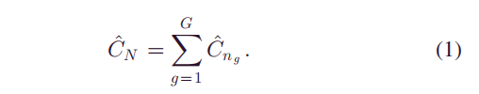
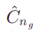
PROBLEM STATEMENT
In smart cities, it is imperative to perform an accurate future coincident peak demand estimation for the electricity network design, which has the following main challenges.
Different types of properties with various future customers exhibit different consumption behaviors.
The demand diversity among customer loads significantly.
Mathematically, the problem can be defined as follows.
Given that there are G customer categories defined by the demographic data (e.g., household occupancy and wealth level) and N new customers need to be connected to the network, for each category g, the number of new connections is denoted by ng ,where .
In addition, let mg denote the number of existing customers in category g with smart meter data and demographic data for g = 1, ..., G. The target of this problem is to estimate the total coincident peak demand
For each category, we estimate via the metric ADMD,which is traditionally defined as the coincident peak electrical demand per customer when n approaches infinity.
Notes:
在智能城市中，对电网设计进行准确的未来一致峰值需求估计势在必行，其主要挑战如下。
1）未来不同客户的不同类型的房地产表现出不同的消费行为。尽管这些客户可以根据他们的人口统计数据进行分类，但对于每个类别而言，在没有连接到网络时的现有数据的情况下，估计同时出现的高峰需求仍然是一个挑战。
2）用户负荷之间的需求差异显著增加了估计组峰值需求的困难，特别是当新连接的用户数n大大低于网络中现有的用户数时。需要注意的是，需求多样化指的是，随着n的增加，同时出现的峰值需求对个体消费者属性的敏感性降低，反之亦然。这是因为并非所有的客户都同时消费他们的峰值需求。
在数学上，这个问题可以定义如下。鉴于人口统计数据（如家庭入住率和财富水平）定义了G类客户类别，并且N个新客户需要连接到网络，对于每个类别G，新连接的数量用ng表示，另外，让mg表示存在的客户数量，在组g内的智能表数据和人口统计数据,g=1,...G. 这个问题的目标是估计总的一致峰值需求
对于每个分类来说，我们通过ADMD来对Cng进行估计，Cng是定义每个用户的峰值电能消耗，当n接近无限的时候。

Slide 18
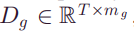
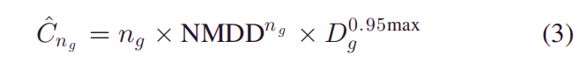
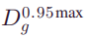
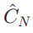
PROBLEM STATEMENT
Extend to
Consequently, based on the smart data of existing customers , ADMDn for n ∈ {1, mg } can be calculated for each category as follows:
Note that it is computationally impractical to calculate for all the n!/n!(mg − n)! possible household combinations, particularly when n << mg . To this end, it is more efficient to randomly select n customers out of mg as many as required. For each category, we obtain the ADMDn curve from n = 1 to mg and then normalize it based on the highest value of each curve.
In this way, the NMDD value NMDDn in [0, 1] can be further used to estimate Cˆng as follows:
where represents the 95th percentile peak demand of Dg . Finally, the total coincident peak demand of the future N customers, , can be obtained by calculating the sum of Cˆng for g = 1, ..., G.
a probabilistic distribution rather than a single-point value due to the large number of combinations
Notes:
本文扩展了ADMD的概念，接下来，基于现成的客户的智能数据，我们就可以计算ADMDn
ADMDn的不现实，特别n<<mg。最后，随机选择n个客户。对于每一个分类来说，获取一个ADMDn的曲线。
Dg0.95max代表95%的峰值需求，
Cng最后总的一致峰值需求，
注意到输出CN是一个概率性分布，而不是单点值，大规模的组合，我们选择了ADMDn。

Slide 19
METHODOLOGIES
03

Slide 20
METHODOLOGIES
A. Proposed Framework
B. Load modelling and Sampling
C. Customer Grouping
D. Probabilistic NMDD Estimation
E. Probabilistic Peak Demand Estimation
Notes:
提出的一种框架
负载建模和采样
消费者分组
概率估计
概率峰值需求估计

Slide 21
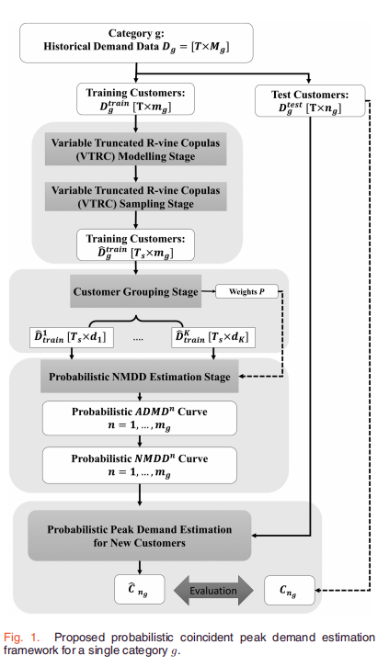
METHODOLOGIES
A.Proposed Framework
As illustrated in Section II, the challenges related to the coincident peak demand estimation are the unknown data of future customers and the influence of demand diversity among customer loads.
To address these challenges, a novel probabilistic peak demand estimation framework shown in Fig. 1 is introduced in this paper. This framework consists of four main stages.
Load modelling and sampling stage
Customer grouping stage
Probabilistic NMDD estimation stage
Probabilistic peak demand estimation stage for new customers
Notes:
如第二节所述，与一致峰值需求估计相关的挑战是，真实客户的未知数据，客户负载需求多样性的影响。为了解决这些挑战，本文介绍了图1所示的一种新的概率峰值需求估计框架。这个框架由四个主要阶段组成。
负载模型和采样阶段；
将智能表的数据分成0.8训练，0.2测试. VTRC, varible truncated couplus。还有Ts的问题。
客户分组阶段；
概率估计的预分组阶段；
概率性NMDD估计阶段；
计算ADMDn的分布，
概率性峰值需求估计阶段；
使用NMDD曲线来计算一致峰值估计结果，

Slide 22
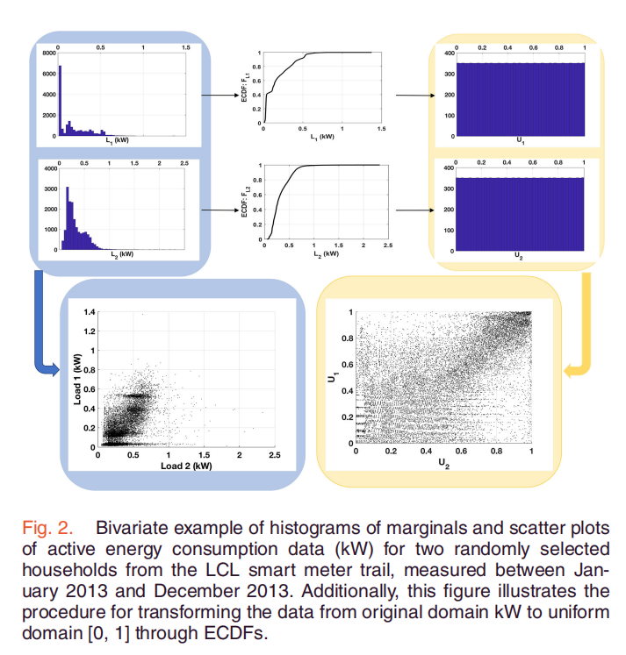
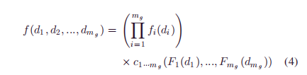
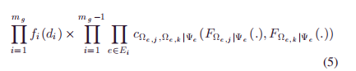
METHODOLOGIES
B.Load modelling and sampling stage
understand current consumers' behavior
model dependence between behavior and meter
illustrate the challenges of modeling highdimensional smart meter data；
Proposed VTRC Modelling approach
Notes:
在对用户数据进行数据训练的基础上，首先建立了住宅用电需求的统计模型。
这一阶段的目的是了解当前消费者的行为，并通过插入和外推历史智能电表测量值来建模他们的依赖结构。
然后，构造的模型可以根据需要生成尽可能多的样本，以表示具有未知数据的未来客户的潜在消费行为。
为了说明高维智能电表数据建模的挑战，图2显示了从不利住户和1个住户住户中随机选择的两个客户的需求数据示例。
这个图的数据是来着伦敦低碳项目，2013年一整年的数据；
联合概率分布函数，如f(d1,d2,...,dmg); 边际密度函数，分布函数
可以观察到需求数据在不同客户之间呈现出高度非高斯的边缘分布和复杂的非线性依赖结构，即使他们属于同一类别。为了解决这些问题，我们提出了一个新的VTRC模型，在保留经验数据的同时，对每个类别的家庭进行负荷建模和抽样程序。边缘分布和捕获多元非线性依赖关系
图模型
降维处理。

Slide 23
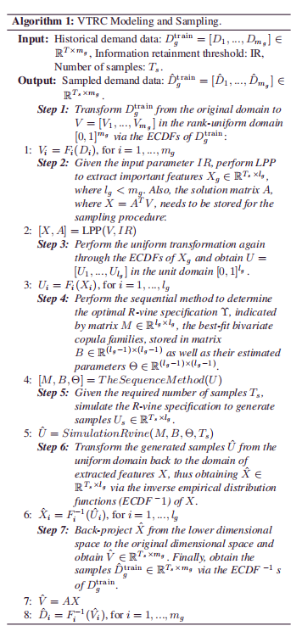
METHODOLOGIES
To address the problem of high dimensionality, a variable truncated R-vine copula method is proposed in this work to make the R-vine modeling and sampling procedure executed in a lower dimensional space constructed with important features.
locality preserving projection(LPP)
To summarize, the proposed VTRC modelling and sampling algorithm is outlined in Algorithm 1.
Notes:
为了从根本上解决高维性问题，本文提出了一种可变截尾R-vine copula方法，使R-vine建模和采样过程在具有重要特征的低维空间中执行；
LPP保局部投影
提出了算法1的VTRC建模和采样；

Slide 24
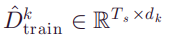
METHODOLOGIES
C. Customer Grouping
When calculating the ADMDn for n customers at the next stage, the existence of demand diversity necessitates selecting a large amount of replicates that consist of different combinations of n customers.
correlation-based clustering not distance-based clustering
because the occurence of the coincident peak demand is highly related to the correlations of their electricity consumption behaviors.
calculate the correlation matrix R=(ri,j)i,j=1,...,mg.
Notes:
下一次计算n个客户的ADMDn的阶段，需求多样性要求选择一个大量重复的客户，又不同的组合；
不是从随机选择

Slide 25
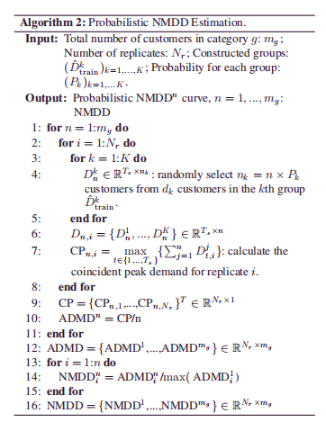
METHODOLOGIES
D. Probabilistic NMDD estimation
Using (2), the distribution of ADMDn for each n ∈{1, .., mg } can be calculated based on the constructed groups, thus obtaining the probabilistic ADMDn curve. Then, the probabilistic NMDDn curve is obtained by normalizing the ADMDn curve. The calculation procedure is outlined in Algorithm 2.
E. Probabilistic Peak Demand Estimation
Given ng new customers from category g, the distribution of the coincident peak demand Cˆng ∈ RNr ×ng can be estimated using (3) based on the obtained probabilistic NMDD curve. Compared with the actual coincident peak demand Cng , the performance of the proposed framework can be assessed via the evaluation metrics, introduced in the next section.

Slide 26
EVALUATION METRICS
04

Slide 27
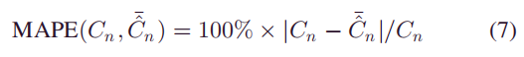
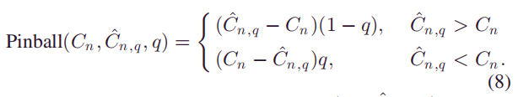
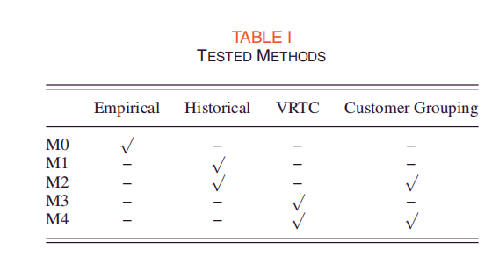
EVALUATION METRICS
A. Evaluation Metrics
1) Mean Absolute Percentage Error：
2) Pinball Loss Function:
B. Comparisons
To illustrate the benefits of each stage of the proposed frame work, a series of tested methods are compared in this paper. Note that M0 is a point estimation method, whereas M1, M2, M3, and M4 are all probabilistic methods.
1) M0: Empirical ADMD:
2) M1: Historical NMDDn:
3) M2: Historical NMDDn and Customer Grouping:
4) M3: VTRC NMDDn:
5) M4: VTRC NMDDn and Customer Grouping:
弹球函数解释
Notes:
评估度量
平均绝对比误差，Cn为实际的一致峰值需求，上尖为估计值，上划线的是期望，使用MAPE来评价估计模型的性能，n为客户数量。
三个因素，标定，锐度和可靠性，用来评估概率评估模型；
分位数模型；

Slide 28
CASE STUDY
05

Slide 29
CASE STUDY
A. Data Description
The LCL smart meter trials provide a valuable opportunity to understand residential electricity consumption behaviors and to assess the benefits from exploiting smart metering for distribution network design.
In the LCL project, Landis and Gyr(L+G) E470 electricity meters were installed in 2639 residential households across the Mayor of London’s Low Carbon Zones and the London Power Networks distribution network license area operated by U.K. Power Networks [5]. Specifically, the Engineering Instrumentation Zones of the LCL trial include the areas of Brixton, Merton, and Queen’s Park. Regarding the collected data, the LCL demand dataset consists of 17 520 half-hourly measurements of demand across 2639 customers in kW for a full calendar year from January 1, 2013, to December 31,2013.
Notes:
LCL智能电表试验为了解居民用电行为和评估利用智能电表进行配电网设计的好处提供了宝贵的机会。
在LCL项目中，Landis和Gyr（L+G）E470电表安装在伦敦低碳区市长和英国电网运营的伦敦电网配电网许可区的2639户居民家庭中[5]。具体来说，LCL试验的工程仪表区包括Brixton、Merton和Queen's Park。关于收集的数据，LCL需求数据集包括从2013年1月1日到2013年12月31日的整个日历年2639个客户（单位：千瓦）的17520个半小时需求测量。
此外，数据集还记录了参与家庭的各种社会经济数据。在本文中，我们主要关注与家庭入住率（即居住在房地产中的人数）和财富水平（即，根据将所有参与家庭映射到ACORN组来确定）相关的数据。特别地，我们考虑三种类型的居住，即1个居住者、2个居住者和3个居住者，以及三种财富类别，即不利的、舒适的和日益富裕的。因此，九个类别（即，g=9）被定义为入住率和财富水平的组合，每个类别的客户数量见表二。请注意，有关测试的LCL数据集的更详细描述，请参阅文献（例如[28]）

Slide 30
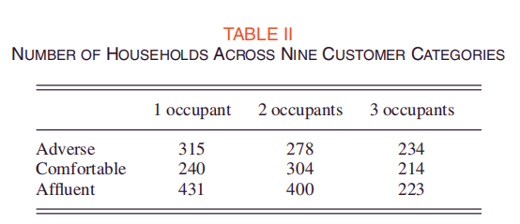
CASE STUDY
A. Data Description
In addition, various socioeconomic data of the participating households were also recorded in the dataset. In this paper,we focus on the data pertaining to household occupancy (i.e.,the number of people living in the property) and wealth level (i.e., determined based on mapping all participating households to ACORN groups). In particular, we consider three types of occupancy, namely, 1 occupant, 2 occupants, and 3 occupants,as well as three wealth classes, namely, Adverse, Comfortable, and Affluent in an increasing order. Consequently, nine categories (i.e., G = 9 ) are defined as the combinations of occupancy and wealth level, and the number of customers for each category is given in Table II. Note that more detailed descriptions of the tested LCL dataset can be found in the literature(e.g., [28]).
Notes:
LCL智能电表试验为了解居民用电行为和评估利用智能电表进行配电网设计的好处提供了宝贵的机会。
在LCL项目中，Landis和Gyr（L+G）E470电表安装在伦敦低碳区市长和英国电网运营的伦敦电网配电网许可区的2639户居民家庭中[5]。具体来说，LCL试验的工程仪表区包括Brixton、Merton和Queen's Park。关于收集的数据，LCL需求数据集包括从2013年1月1日到2013年12月31日的整个日历年2639个客户（单位：千瓦）的17520个半小时需求测量。
此外，数据集还记录了参与家庭的各种社会经济数据。在本文中，我们主要关注与家庭入住率（即居住在房地产中的人数）和财富水平（即，根据将所有参与家庭映射到ACORN组来确定）相关的数据。特别地，我们考虑三种类型的居住，即1个居住者、2个居住者和3个居住者，以及三种财富类别，即不利的、舒适的和日益富裕的。因此，九个类别（即，g=9）被定义为入住率和财富水平的组合，每个类别的客户数量见表二。请注意，有关测试的LCL数据集的更详细描述，请参阅文献（例如[28]）

Slide 31
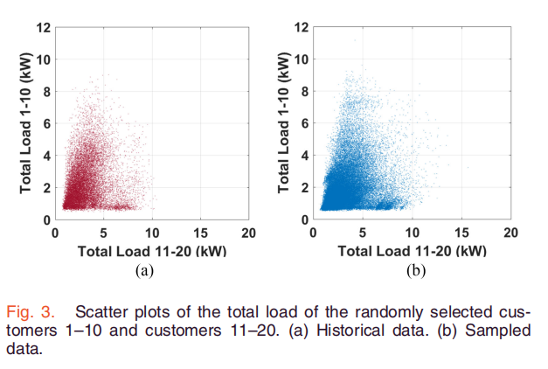
CASE STUDY
B. Visual Comparison
An example of 20 randomly selected customers from Adverse1 is given in this part to visually inspect the superior performance of the proposed R-vine copulas sampling method.Given the historical dataset of size 17 520 × 20, the output of the proposed VTRC modeling and sampling stages is a larger set of sampled data of size 100 000 × 20 (i.e., Ts = 100 000) with the information retainment threshold IR = 0.5.
In order to present and compare these two sets of 20-D data, the total load of the first ten customers (vertical axis) and the rest ten customers (horizontal axis) is shown in Fig. 3.
Notes:
本部分以20个随机抽取的不利客户为例，对所提出的R-vine连接点抽样方法的优越性能进行了可视化检验，给出了历史数据集大小为17520×20，所提出的VTRC建模和抽样阶段的输出是一组更大的样本数据，大小为1000000×20（即TS=100000），信息保留阈值Ir=0.5。
为了呈现和比较这两组20-D数据，前十个客户（垂直轴）和后十个客户（水平轴）的总负载如图3所示。

Slide 32
CASE STUDY
B. Visual Comparison
As can be seen, the sum of the sampled load data [see Fig. 3(b)] can accurately represent the complex nonlinear dependence structure of the historical data [see Fig. 3(a)] with only 50% information retained. Also, it is important to note that more extreme values can be obtained via using the proposed sampling method, which may improve the accuracy of the final estimated coincident peak demand.
Regarding the central processing unit times, the proposed VTRC method was implemented in MATLAB 2017b and run on an Intel Xeon E5-2690 PC with eight cores. For the case of IR = 1, which means no dimensionality reduction is performed, the total time including modeling and generating 100 000 samples is about 4429.32 s, whereas it only takes 810.66 s for IR = 0.5 (i.e., R-vine is performed on a 9-D dataset). Both the great capability of capturing the dependence structure and the significantly reduced computational cost demonstrate the efficiency and effectiveness of the proposed VTRC approach.
Notes:
可以看出，抽样荷载数据的总和[见图3（b）]可以准确地表示历史数据的复杂非线性相关结构[见图3（a）]，只保留50%的信息。此外，需要注意的是，通过使用所建议的采样方法，可以获得更多的极值，这可能会提高最终估计的一致峰值需求的准确性。
关于中央处理器的时间，所提出的VTRC方法在Matlab 2017b中实现，并在Intel Xeon E5-2690 PC上运行，具有八个核。对于ir=1的情况，也就是说没有进行降维，包括建模和生成100000个样本在内的总时间约为4429.32 s，而对于ir=0.5只需要810.66 s（即R-vine在9-D数据集上执行）。该方法捕获依赖结构的能力强，计算成本显著降低，证明了该方法的有效性和有效性。

Slide 33
CASE STUDY
C. Results Across Different Numbers of Customers 1
In this section, the performance of the proposed probabilistic peak demand estimation method is evaluated based on a single category of customers, Adverse and 1 occupant, with different numbers of future customers. As illustrated in Fig. 1, all 315 customers in this category are first randomly partitioned into training customers of size mg = 249 and test customers of size ng = [10, 20, 40, 50, 60].
For each number of ng , in order to obtain the distribution of the actual coincident peak demand, we randomly select 100 000 sets of customers from the whole set of customers except for the training ones. For the tested methods M3 and M4, as introduced in Section IV, the first step is to model the historical load data of the mg = 249 training customers via the proposed VTRC method. Then, a large number of samples are generated via simulating the constructed model. Note that the input parameters of this stage are given as follows:number of samples Ts = 100 000 and information retainment threshold for LPP IR = 0.5. Afterwards, for M2 and M4 that include the correlation-based consumer grouping stage, we set the number of clusters for this category to Kg = 4. For the stage of probabilistic NMDD estimation, we set the number of replicates Nr = 100 000 for all the methods. In terms of the evaluation metrics, we evaluate the point estimation results and the probabilistic estimation results of M1, M2, M3, and M4 via the metrics MAPE and the pinball loss, shown in Tables III and IV, respectively.
Note that, for each ng , the benchmark value of the estimated peak demand is the mean value of the actual peak demand distribution when calculating the pinball loss and the MAPE. Also, for the MAPE, the point estimated peak demand is the mean value of the probabilistic estimated values. In particular, the results presented in Tables III and IV both indicate that the proposed framework M4, consisting of the VTRC method and the correlation-based grouping strategy, exhibits superior performance to the other methods. This is evidenced by the gradually reduced MAPE and pinball loss values from historical data-based estimation to sample-based estimation, from random customer selection to clustering-based selection. In terms of the average performance across all the ng s, when including the customer group stage, M2 has approximately 6.06% and 6.12% improvements when compared with M1 in terms of the point estimation result and the probabilistic estimation result, respectively.
Additionally, the introduction of the load modeling and sampling stage in M3 presents 66.99% and 68.17% reductions in the MAPE and pinball loss values of M1. Finally, the combination of both sampling and grouping stages makes further enhancements based on M3, as indicated by a 17.09% reduced MAPE value and a 8.27% reduced pinball loss value.
Notes:
在本节中，基于单个类别的客户（不利客户和1个占用客户）以及不同数量的未来客户，评估了所提出的概率峰值需求估计方法的性能。如图1所示，该类别的315名客户首先被随机分为大小为mg=249的培训客户和大小为ng=[10、20、40、50、60]的测试客户。
对于每一个NG数量，为了得到实际重合峰需求的分布，我们从整组客户中随机抽取10万组客户，培训客户除外。对于第四节中介绍的测试方法M3和M4，第一步是通过提议的VTRC方法对MG=249培训客户的历史负载数据进行建模。然后，通过模拟所构建的模型，生成大量的样本。注意，本阶段的输入参数如下：样本数ts=100000，lpp-ir的信息保留阈值=0.5。然后，对于包含基于相关性的消费者分组阶段的M2和M4，我们将该类别的集群数设置为kg=4。对于概率NMDD估计阶段，我们设置所有方法的复制次数nr=100000。在评估指标方面，我们分别通过表三和表四所示的指标MAPE和弹球损失评估M1、M2、M3和M4的点估计结果和概率估计结果。
注意，对于每个天然气，估计峰值需求的基准值是计算弹球损失和MAPE时实际峰值需求分布的平均值。此外，对于MAPE，点估计峰值需求是概率估计值的平均值。特别是，表III和表IV中的结果都表明，由VTRC方法和基于相关性的分组策略组成的拟议框架M4表现出比其他方法优越的性能。从基于历史数据的估计到基于样本的估计，从随机客户选择到基于聚类的选择，MAPE和Pinball损失值逐渐降低，这一点可以证明。就所有天然气的平均性能而言，当包括客户群阶段时，与M1相比，M2在点估计结果和概率估计结果方面分别提高了6.06%和6.12%。
此外，在M3中引入负荷建模和取样阶段，M1的MAPE和弹球损失值分别降低了66.99%和68.17%。最后，采样和分组阶段的结合进一步增强了基于M3的性能，如MAPE值降低17.09%和销球损失降低8.27%所示。

Slide 34
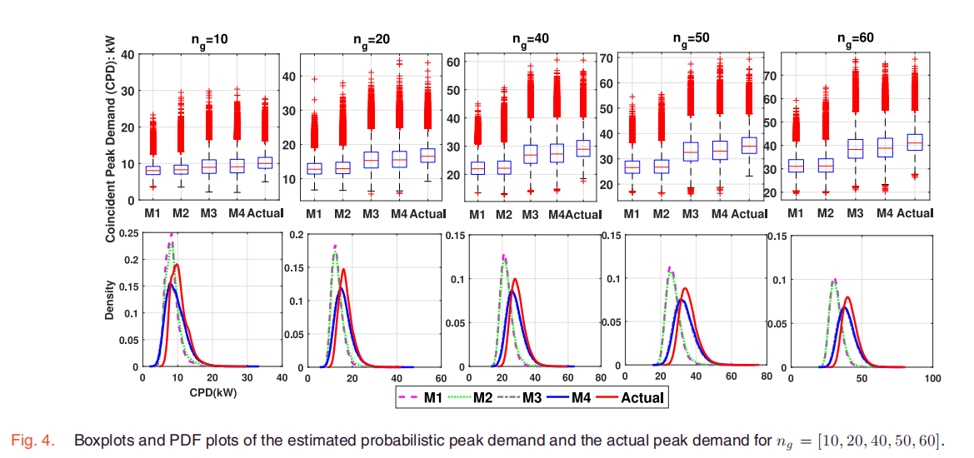
CASE STUDY
C. Results Across Different Numbers of Customers 2
In addition, Fig. 4 presents the boxplots and the PDF plots of the estimated probabilistic peak demand for each method when ng = [10, 20, 40, 50, 60]. It can be observed that the sample_x0002_based methods (i.e., M3 and M4) exhibit better estimation than the historical-data-based methods (i.e., M1 and M2) in terms of the distribution of the estimated peak demand. Additionally,the range of the estimated values obtained via M3 and M4 can almost cover the actual values, whereas parts of extreme actual values are out of the range of the estimated values obtained using M1 and M2. This also demonstrates the importance of the proposed load modeling and sampling method, VTRC, which can capture the tail dependencies among various consumers and obtain more probable coincident peak demand via using the vast number of samples rather than the limited number of historical measurements.
Notes:
此外，图4显示了当ng=[10，20，40，50，60]时每个方法的估计概率峰值需求的箱线图和PDF图。可以观察到，在估计的峰值需求分布方面，样本化方法（即，m3和m4）比基于历史数据的方法（即，m1和m2）表现出更好的估计。此外，通过m3和m4获得的估计值的范围几乎可以覆盖实际值，而极端实际值的部分超出了使用m1和m2获得的估计值的范围。这也说明了所提出的负载建模和采样方法vtrc的重要性，vtrc可以捕获不同用户之间的尾部依赖性，以及
通过使用大量样本而不是有限数量的历史测量，获得更可能的一致峰值需求。

Slide 35
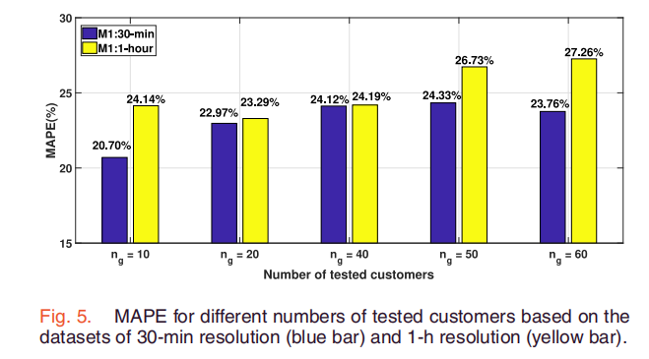
CASE STUDY
C. Results Across Different Numbers of Customers 2
Another critical aspect that impacts the accuracy of the estimated coincident peak demand is the time resolution of smart meter data. Theoretically, low time resolution of the smart meter data will result in an inherent underestimation of the aggregated peak load. In order to demonstrate the importance of high-resolution data, an additional case study based on lower resolution data (i.e., 1-h resolution data obtained based on the 30-min data) is conducted by use M1 to estimate the peak demand across different numbers of tested customers. Fig. 5 presents the bar plots of the MAPE values for the cases of 30-min resolution data and 1-h resolution data. Note that in this case, we do not take the absolute value of Cn − ¯Cˆn when calculating the MAPE using (7). Therefore, positive and negative MAPE values represent the underestimation and the overestimation, respectively. As can be seen, in terms of the mean value of the estimated peak demand, the lower time resolution indeed leads to higher positive estimation errors than those of the high-resolution case, which indicates a more severe underestimation problem when using the dataset with 1-h resolution.However, as the proposed method is applicable to arbitrary time resolution, the accuracy of the estimated peak demand can be further improved if more fine-grained data can be employed.
Notes:
影响估计一致峰值需求准确性的另一个关键方面是智能电表数据的时间分辨率。理论上，智能电表数据的低时间分辨率将导致对聚合峰值负载的固有低估。
为了证明高分辨率数据的重要性，使用M1进行基于低分辨率数据（即基于30分钟数据获得的1小时分辨率数据）的额外案例研究，以估计不同数量受测客户的峰值需求。图5显示了30分钟分辨率数据和1小时分辨率数据情况下的MAPE值条形图。注意在这里面
在使用（7）计算MAPE时，我们不取Cn−c_n的绝对值。因此，正和负MAPE值分别代表低估和高估。可以看出，就估计峰值需求的平均值而言，较低的时间分辨率确实会导致比
高分辨率的情况表明，当使用具有1-h分辨率的数据集时，存在着一个更严重的低估问题，但是，由于所提出的方法适用于任意时间分辨率，如果能够使用更多的细粒度数据，估计的峰值需求的精度可以进一步提高。

Slide 36
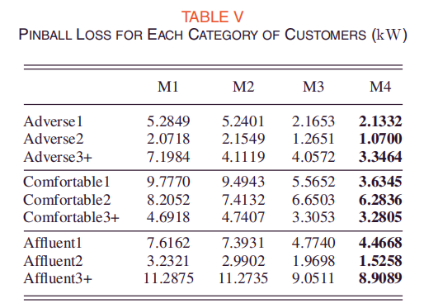
CASE STUDY
D. Results for Each Category
Although the previous results have demonstrated the superior performance of the proposed approach in a single category, it is also imperative to extend the analysis to the other categories.
For each category, five replicates of training and test sets are constructed by randomly partitioning the customers of each category into 80% and 20%, respectively. The parameters of the VTRC model in Section V-B are retained in this case, whereas the number of clusters at the customer grouping stage is set to different values for different categories, as follows: K = [K1 , K2 , ..., K9 ] = [5, 10, 30, 6, 20, 4, 4, 20, 20]. Note that all the Kg s are determined by a series of performance tests, and they may not be the optimal number for each group. For all the tested methods, the probabilistic estimation performance for each category is shown in Table V, as evaluated by the average pinball loss value of all five replicates.
Notes:
尽管之前的结果已经证明了所提出的方法在单个类别中的优越性能，但也必须将分析扩展到其他类别。
对每个类别，通过将每个类别的客户随机分为80%和20%来构建5个训练和测试集副本。在这种情况下，V-B部分中的VTRC模型的参数被保留，而客户分组阶段的集群数量被设置为不同类别的不同值，如下所示：k=[k1，k2，…，k9]=[5，10，30，6，20，4，4，20，20]。请注意，所有的kg s都是由一系列性能测试确定的，它们可能不是每组的最佳数量。对于所有测试方法，每种类别的概率估计性能如表V所示，由五次重复的平均弹球损失值进行评估。

Slide 37
CASE STUDY
D. Results for Each Category
As shown above, the order of the probabilistic estimation’s performance across different methods is highly consistent with the results shown in Table IV. The proposed method M4 always has the lowest pinball loss values for all nine categories, whereas the categories with 3+ occupants exhibit higher pinball loss values than the other types of occupancy.
Meanwhile, for most of the tested methods, the average pinball loss displays increasing values with an ascending order of wealth levels from Adverse to Affluent. Both of these results may be because for larger and wealthier households, consumers’ habits present higher diversity with more types of electrical appliances (e.g., electric vehicle). Additionally, for some specific categories (e.g., Adverse2 and Comfortable3+), M2 presents slightly higher pinball loss values than M1.
This issue could be caused by the inappropriate number of clusters determined in the customer grouping stage. Therefore, future work could be focused on investigating how to determine the optimal or suitable number of groups based on the performance of estimation.
Notes:
如上所示，概率估计在不同方法中的性能顺序与表四所示的结果高度一致。所建议的方法M4在所有9个类别中始终具有最低的弹球损失值，而具有3+居住者的类别比其他类型的OCC具有更高的弹球损失值。上升。同时，对于大多数
测试方法中，平均的弹球损失显示出随着财富水平从不利到富裕的上升顺序而增加的价值。这两个结果都可能是因为对于更大和更富裕的家庭来说，消费者的习惯随着更多类型的电器（如电动汽车）呈现出更高的多样性。此外，对于某些特定类别（例如，对手2和舒适3+），M2的弹球损失值略高于M1。
此问题可能是由于在客户分组阶段确定的集群数量不适当造成的。因此，未来的工作可以集中在研究如何根据估计的性能来确定最佳或合适的组数。

Slide 38
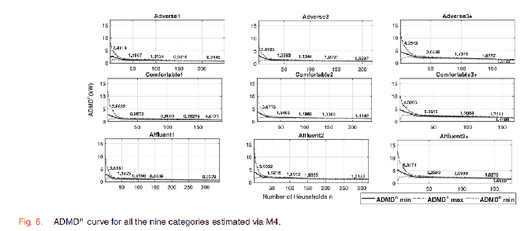
CASE STUDY
D. Results for Each Category 2
To visually inspect the ADMD curve and then applied to the case of multiple categories;
It can be concluded that wealth and occupancy information are both useful proxies in inferring the diversified demand for the network design in smart cities.
...thus highlighting the importance of considering demand diversity while estimating the peak demand for practical applications such as operation and planning.
..., indicating the overestimation problem of using the heuristic value and demonstrating the benefits of employing the proposed data-driven approach.
Notes:
为了目视检查ADMD曲线，然后将其应用于多个类别的情况，图6中给出了一个M4示例，该示例显示了作为所有九个类别家庭函数的最大、最小和平均ADMDN值；图中提供的具体数字为n=[1、5、10、…、100、150、mg]个家庭。
从图中可以看出，对于所有类别，由于需求多样化的影响，增加的家庭数量中的估计ADMDN值对单个客户属性的敏感性降低。此外，在大多数情况下（如舒适性类别和2人类别），财富和居住水平不断增加的家庭对每N个家庭的平均居住时间（ADMDN）估计值较高。可以得出结论，财富和居住信息都是推断SMA网络设计多样化需求的有用代理。RT城市。
此外，随着被考虑的家庭数量的增加，每一类的多样化峰值需求也显著减少（例如，对于富裕3+，admd∞大约比admd1低10倍），从而突出了在估计实际应用的峰值需求时考虑需求多样性的重要性。比如运营和规划。
最后，与广泛应用于dno网络设计的经验值（即admd∞=2 kw）相比[27]，不同类别的较低值如图6所示，表明使用启发式值的高估问题，并证明了使用所提出的数据驱动方法的好处。

Slide 39
CASE STUDY
E. Results for Multiple Category
The analyses in the previous sections have illustrated that the tested methods for each of the nine categories show significant differences in the performance of peak demand estimation.
However, it is a more realistic scenario for a DNO to perform the network design across multiple categories with different numbers of future customers.
Consequently, in this section, an example of a multicategory case is described as follows: a new development of 50 new one-bedroom flats, 30 new two-bedroom flats,and ten new three-bedroom houses in the areas that fall within the ACORN categories designated as Adverse, Comfortable,and Affluent, respectively. The total coincident peak demand for all the tested methods can be estimated following the steps introduced in Section II by using the probabilistic NMDD values, obtained by normalizing ADMD n curves shown in Fig. 6.Comparing the estimation performance of the different tested methods, it is apparent that the gradually decreased MAPE and pinball loss values shown in Table VI indicate the advantages of considering the load modeling and sampling stage, the customer grouping stage, and their combinations during the peak demand estimation procedure. Specifically, in terms of the MAPE, M4 has an approximately 92% improvement when compared with the empirical method M0. Additionally, from M4 to M1, there is an approximately 42.21% reduction in the calculated pinball loss value. Note that the pinball loss value cannot be calculated for the empirical method M0 because it is a deterministic estimation method
Notes:
前几节中的分析表明，9个类别的测试方法在峰值需求估计的性能上都有显著差异。
但是，对于一个DNO来说，跨多个类别、未来客户数量不同进行网络设计是一个更现实的方案。
因此，在本节中，一个多类别案例的例子描述如下：新开发50套新的一居室公寓、30套新的两居室公寓和10套新的三居室住宅，这些住宅分别属于“不利”、“舒适”和“富裕”类别。所有测试方法的总一致峰值需求可以按照第二节中介绍的步骤使用概率NMDD值进行估计，该值是通过将图6所示的ADMD N曲线归一化获得的。比较不同测试方法的估计性能，很明显，MAPE和Pinball的逐渐降低会导致表六所示的SS值表明了在峰值需求估计过程中考虑负荷建模和采样阶段、客户分组阶段及其组合的优势。具体来说，在MAPE方面，与经验方法m0相比，m4有大约92%的改善。此外，从M4到M1，计算出的销球损失值减少了约42.21%。注意，经验方法m0不能计算弹球损失值，因为它是一种确定性估计方法。

Slide 40
CONCLUSION
06

Slide 41
CONCLUSION
In future smart cities, the coincident peak demand estimation of new customers is one of the key challenges for designing power equipment such as substations and power delivery lines.
This paper proposed a data-driven probabilistic peak demand estimation method that includes four main stages.
In the load modeling and sampling stage, a novel VTRC method was proposed to capture the complex dependencies among consumers.
In addition, a correlation-based hierarchical clustering method was implemented in the customer grouping stage to improve the performance of peak demand estimation.
In this work, a vast number of fine-grained smart meter data and the corresponding sociodemographic data across 2639 customers were provided by the LCL smart meter trial.
Nine customer categories were constructed according to the information of household occupancy (i.e., 1, 2, and 3+) and wealth level (i.e., Adverse,Comfortable, and Affluent).
Subsequently, M1, M2, M3, and M4 were performed and compared in the context of different numbers of ng .
Moreover, this analysis was conducted for each category.
Finally, the case of multiple categories peak demand estimation was investigated. Comparing the calculated MAPE and pinball loss values of the tested methods, major conclusions stemming from the analysis are that the performance of the estimated peak demand exhibits gradual improvements from the empirical method to the data-driven method, from using historical data to employing generated samples, and from random customer selection to cluster-based selection.
Further research could focus on developing the proposed peak load estimation method for a more complex situation with distributed photovoltaic, storages, and demand response.
Notes:
在未来的智能城市中，新用户的一致峰值需求估计是变电站、送电线路等电力设备设计的关键挑战之一，
本文提出了一种包括四个主要阶段的数据驱动概率峰值需求估计方法。在负荷建模和抽样阶段，提出了一种新的VTRC方法来捕获用户之间的复杂依赖关系，并在客户分组阶段实现了一种基于相关的层次聚类方法，以提高峰值需求估计的性能。
在这项工作中，LCL智能电表试验提供了2639个客户的大量细粒度智能电表数据和相应的社会人口统计数据。
根据家庭入住率（1、2和3+）和财富水平（不利、舒适和富裕）的信息构建了九个客户类别。
随后，在不同数量的ng下进行M1、M2、M3和M4并进行比较。此外，对每个类别进行了分析。
最后，研究了多类高峰需求估计的情况。通过比较试验方法计算出的MAPE和Pinball损失值，分析得出的主要结论是：从经验方法到数据驱动方法，从使用历史数据到使用生成的样本，以及从随机客户选择到基于簇的选择，估计峰值需求的性能逐渐改善。
进一步的研究可以集中在为更复杂的情况开发峰值负载估计方法，应用于包括分布式光伏、存储和需求响应等场景。

Slide 42
Thanks.

Slide 43
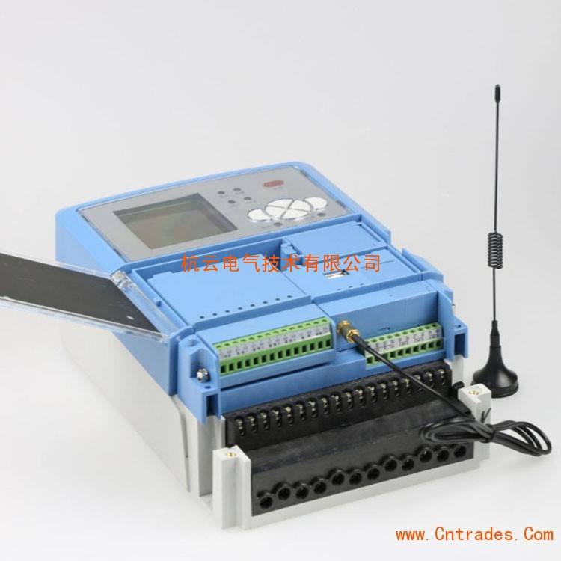
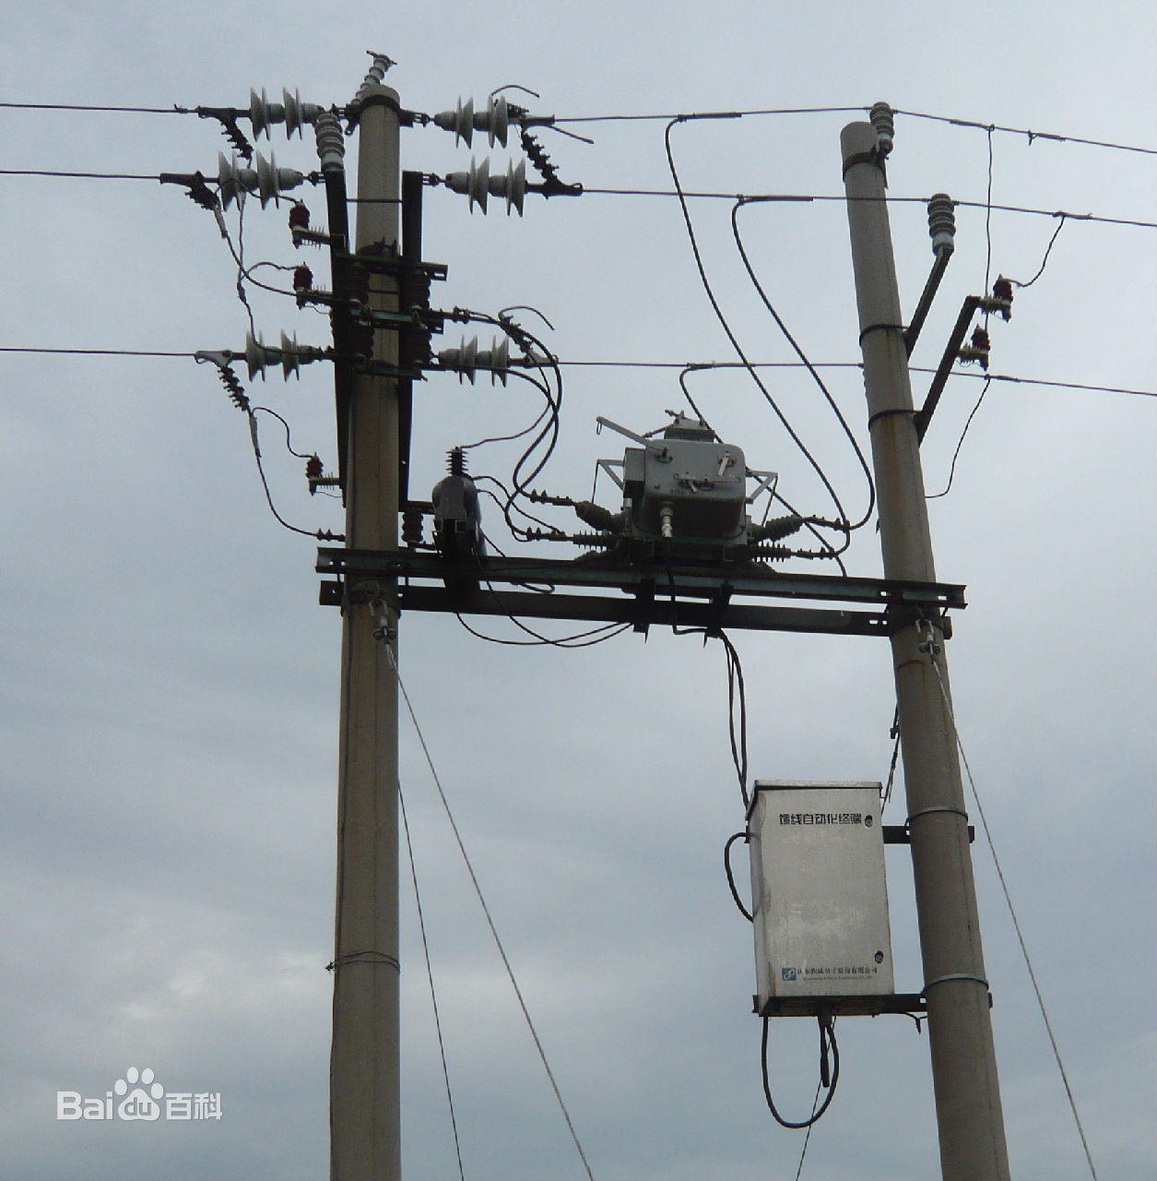
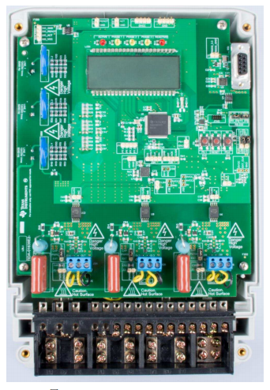
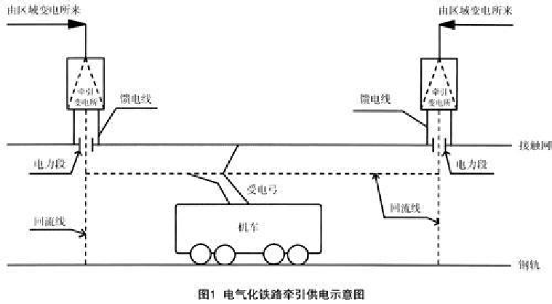
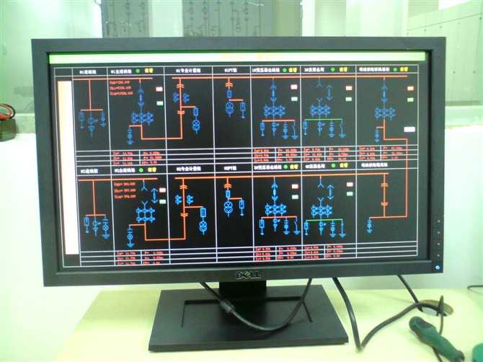
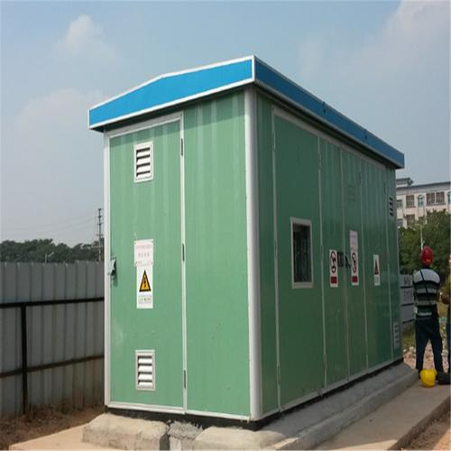
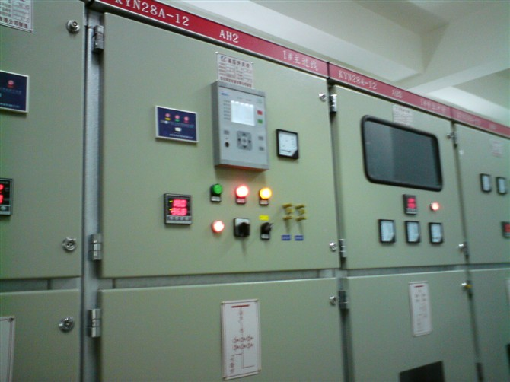
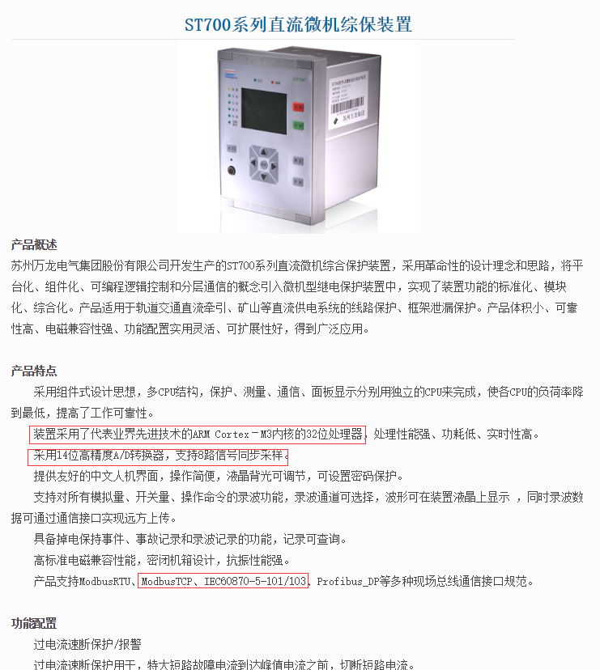
附图1
回项目图
回摘要
Notes:
配电开关监控终端(简称FTU)， 具有遥控、遥信，故障检测功能，并与配电自动化主站通信，提供配电系统运行情况和各种参数即监测控制所需信息，包括开关状态、电能参数、相间故障、接地故障以及故障时的参数,并执行配电主站下发的命令，对配电设备进行调节和控制，实现故障定位、故障隔离和非故障区域快速恢复供电等功能；
IEC61850， 101,103,104规约；
10KV,33kV配电架空线路上；
FTU可采用高性能单片机；
变压器，电容器，线路，电动机保护，控制，自动重合闸等微机综合保护装置等；

Slide 44
附图2 IEC61850
IEC61850标准是电力系统自动化领域唯一的全球通用标准。它通过标准的实现，实现了智能变电站的工程运作标准化。使得智能变电站的工程实施变得规范、统一和透明。不论是哪个系统集成商建立的智能变电站工程都可以通过SCD（系统配置）文件了解整个变电站的结构和布局，对于智能化变电站发展具有不可替代的作用
Notes:
AMI

Slide 45
附图3 AMI advanced meter infrastruture
AMI是英文Advanced Metering Infrastructure的缩写，翻译为高级(或先进)智能量测系统(或架构)。AMI是一套完整的包括智能电表、先进通讯网络、采集器与集中器、后台软件的系统，它能够利用双向通信系统和记录有用户详细负荷信息的智能电表，定时和即时获得用户带有时标的多种计量值，如用电量，用电需求，电压，电流等信息，同时向用户端发布命令和信息，与用户建立紧密联系。主要的功能体现为：改进客户服务、停电管理、窃电监测、线损监测、远程连接/断开用户、电能质量管理、负荷预测、远程改变计量参数、远程升级仪表固件、预付电费购电、电价/事件信息通知，因此AMI是在智能电表和电网公司之间的一种自动双向流通的架构。
Notes:
AMI
http://www.ti.com.cn/solution/cn/smart-e-meter-amr-ami#description
https://www.st.com/zh/applications/energy-generation-and-distribution.html

Slide 46

附图4 Low Carbon London Project

Slide 47
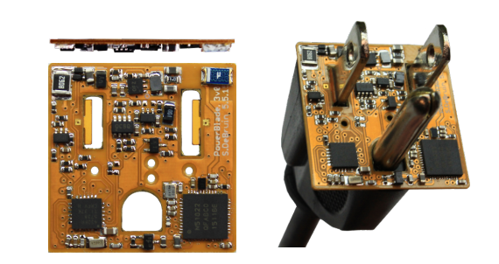
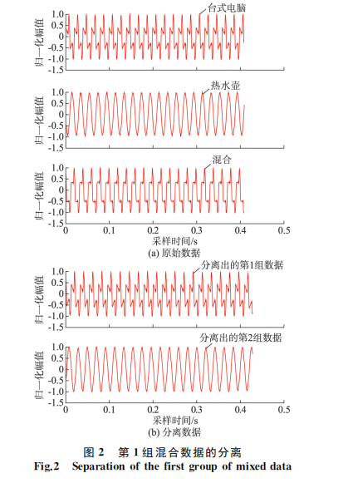
附图5 more fine grained signal processing from HW/SW
NILM (or disaggregation) is a growing research field which began in 1985 with a report written by George W. Hart (MIT) for Electric Power Research Institute (EPRI). NILM is used to discern what electrical loads (e.g., appliances) are running within a home/building using only the aggregate power meter. Why? To help occupants understand how they and their appliance use energy so that they could conserve to either save money, the environment, or both.
回项目图
Notes:
NILM最早是1985，MIT的工程师。用来识别电气负载的，只需要电能表数据就可以了。

Slide 48
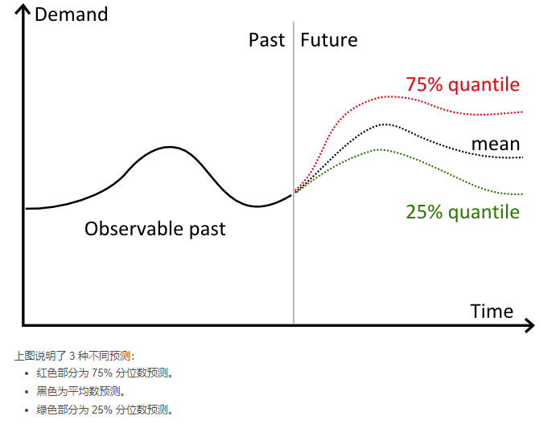
附图5 分位数预测，弹球函数损失
评估分位数预测是一个很微妙的问题。传统预测的目标是使预测尽量接近观察值，与之相比，分位数预测的确会（有意）出现偏差。因此观察值与预测值的比较不尽如人意。借助 pinball 损失函数将返回可解释为分位数预测模式准确度的值。
返回度量页面

Slide 49
附图6 Sensys19'
Micro Power Meter for Energy Monitoring of Wireless Sensor Networks at Scale, IPSN07
Xiaofan Jiang:
Prabal Dutta

